Slide 1
Super Market Sales

Slide 2
The "Supermarket Sales" dataset contains detailed records of 1,000 transactions from a supermarket, offering insights into sales activities across different branches and cities. The dataset covers key transactional details such as product line, unit price, quantity purchased, taxes applied, total sales value, and customer satisfaction ratings. Additional information includes customer demographics (gender, customer type) and payment methods used
Sales Analysis
Customer Behaviour
Financial Performance
Business Strategy
Customer Satisfaction

Slide 3
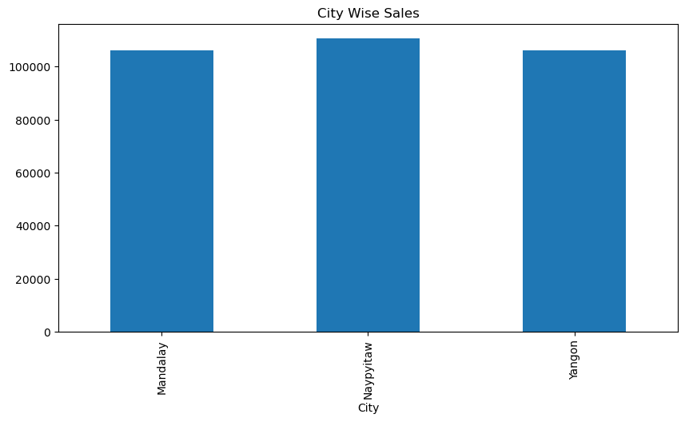
CITY WISE SALES
Naypyitaw has recorded the highest sales, closely followed by the next two cities which have nearly identical figures.

Slide 4
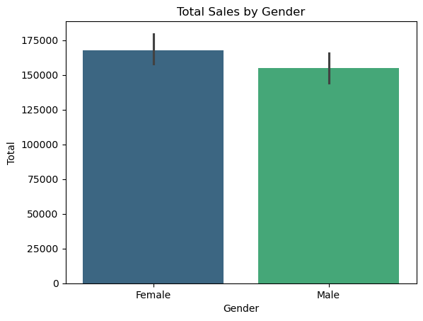
Total Sales by Gender
Most purchase was done by female

Slide 5
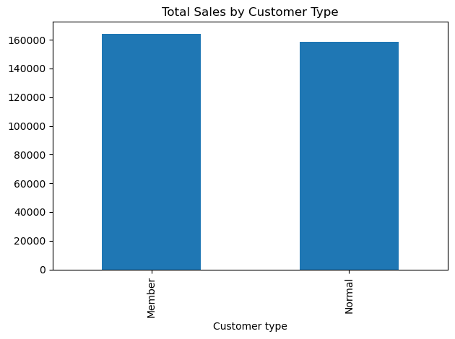
Total Sales by Customer Type
Members have a significantly higher total sales compared to non-members. This suggests that membership programs may be effective in encouraging increased spending among customers

Slide 6
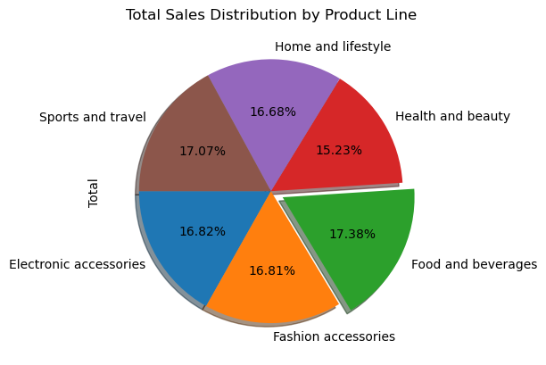
Total Sales Distribution by Product Line
The "Food and Bevarages" product lline have the highest total sales
* "Health and Beauty" have the lowest sales

Slide 7
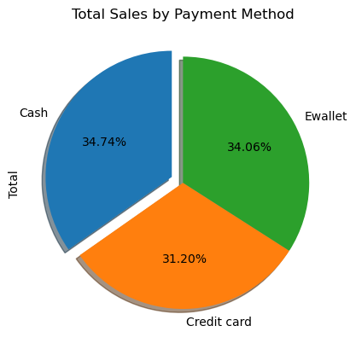
Total Sales by Payment Method
Both Cash and Ewallet contribute nearly equally to total sales, with Cash slightly leading by a fraction (34.74% for Cash vs. 34.06% for Ewallet). This suggests that customers are almost evenly split between preferring traditional cash payments and more modern digital wallets.

Slide 8
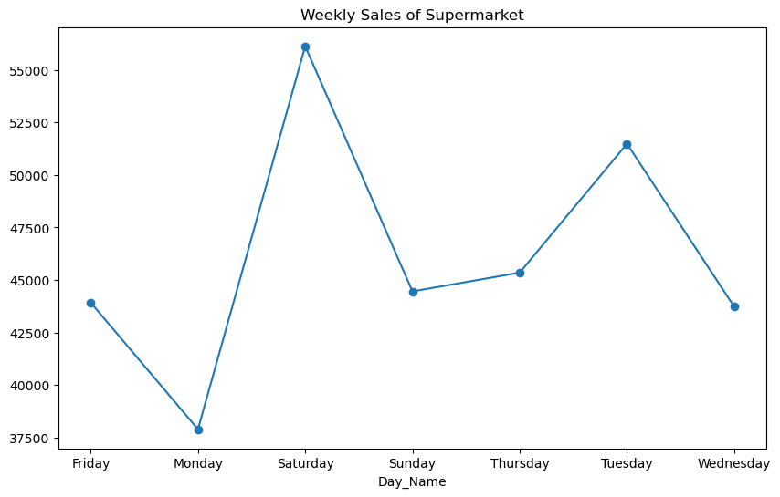
Total Sales by Day of the Week
Highest Sales: Saturday has the highest sales, nearly reaching 50,000.
* Lowest Sales: Monday has the lowest sales, just above 10,000.
* Sales Variation: There is a significant variation in sales throughout the week, indicating different consumer behaviours or promotional activities.

Slide 9
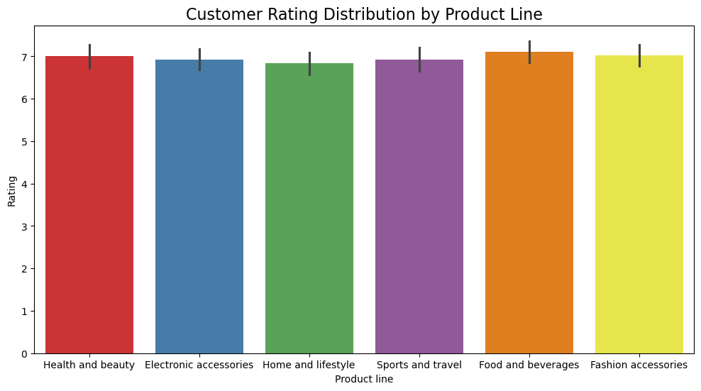
Customer Rating Distribution by Product Line
All product lines have customer ratings in the range of approximately 7, indicating strong customer satisfaction across the board.

Slide 10
Recommendations for Improvement
* Customer Loyalty Programs: If "Member" customers contribute more to revenue, further investments in loyalty programs could be considered to increase repeat purchases.
* Targeted Marketing: Based on product line popularity, you can recommend specific promotional campaigns or discounts to boost underperforming categories.
* Optimizing Payment Methods: If a specific payment method like Ewallet is becoming popular, the store can promote it further by offering incentives for using it.

